Slide 1
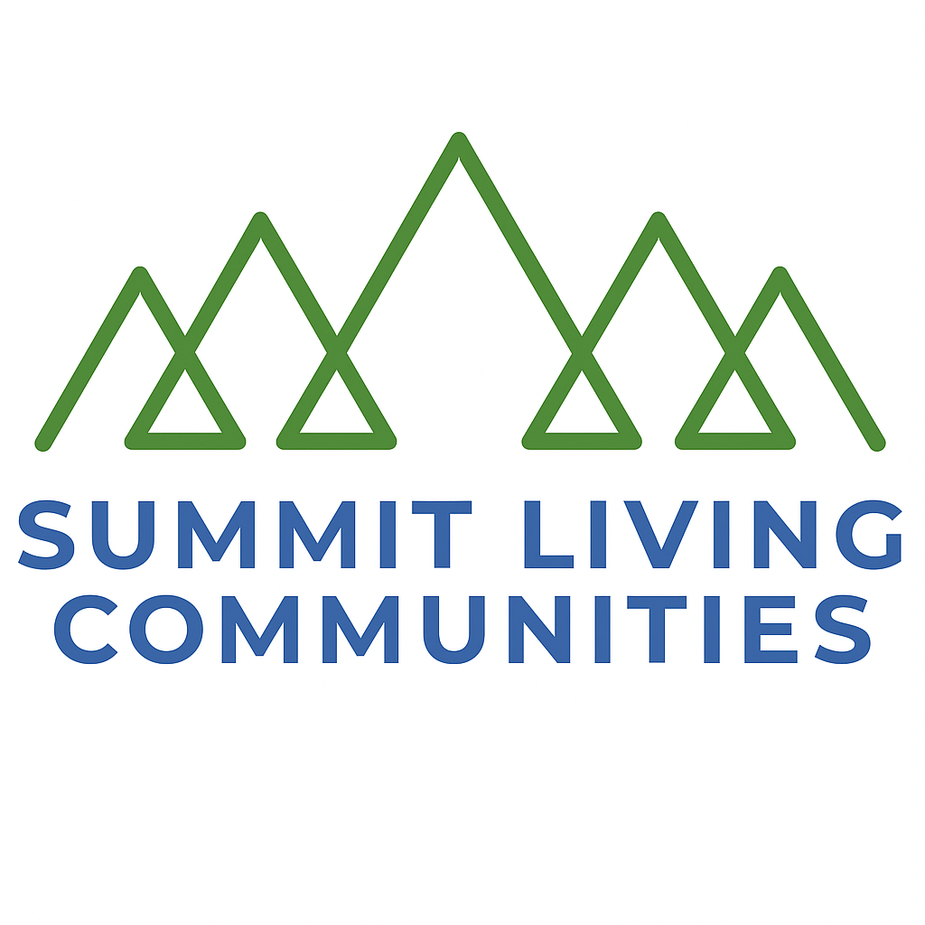
Capstone Project: Milestone 3
Summit Living Communities
Group 2: Devon Townsend, Corey Rose, Amogh Rao, Dustin Carrasco
CMS 799: Consultative Project
Dr. Tricia Richards-Service
December 17, 2025
Authenticity, Inclusion, and Adventure - Building the Story Behind the Brand

Slide 2
Purpose
Take adventure to new heights at Summit Living Communities
Implement a key message that resonates with target audiences
Big Idea: Conquer Your Summit
Offer ideas about Summit’s current situation
Evaluate the media strategy
Notes:
To present a bold vision for a next‑generation community that aligns with the values, mission, and practices of adventure‑oriented older adults seeking more than traditional residential community experiences.

Slide 3
Current Situation
Mission, Values & the Role of Communications
Mission
Summit Living Communities supports active adults 55+ who want to live fully through adventure, connection, and access to the outdoors.
Values
Adventure First • Authentic Community • Environmental Stewardship • Freedom Through Simplicity • Inclusion & Access
Role of Communications
Communications translates Summit’s mission and values into clear, consistent expectations for how the community is experienced and understood.
Notes:
This slide grounds us in who Summit is today.
The community is designed for active adults 55+ who see this stage of life as an opportunity to stay engaged, adventurous, and connected.
Summit’s values reinforce that lifestyle and guide how the community shows up day to day.
Communications plays a key role by making sure those values are clearly understood and consistently reflected in how the brand is presented and experienced.

Slide 4
Current Situation
Communications Challenges & Key Insights
Current Challenges
The Summit lifestyle is not always visible early in the discovery process
Much of the market relies on similar lifestyle language, making meaningful differentiation harder
Audiences depend heavily on digital research and peer experiences before engaging
Risks if Unaddressed
Misalignment between Summit’s values and audience perception
Missed opportunities to build early trust and emotional connection
Research & Inputs
AARP research on lifestyle transitions among adults 50+
Industry trends on digital discovery and peer storytelling
Notes:
This slide highlights the communications reality.
While Summit’s mission and values are strong, the lifestyle itself isn’t always visible early enough for people researching their options.
The market also tends to sound the same, which makes standing out more difficult.
Because this audience relies heavily on digital research and peer experiences, there’s a real risk of misalignment if the story isn’t clear.
These insights, supported by AARP research and industry trends, shape why communications needs to be intentional and focused.

Slide 5
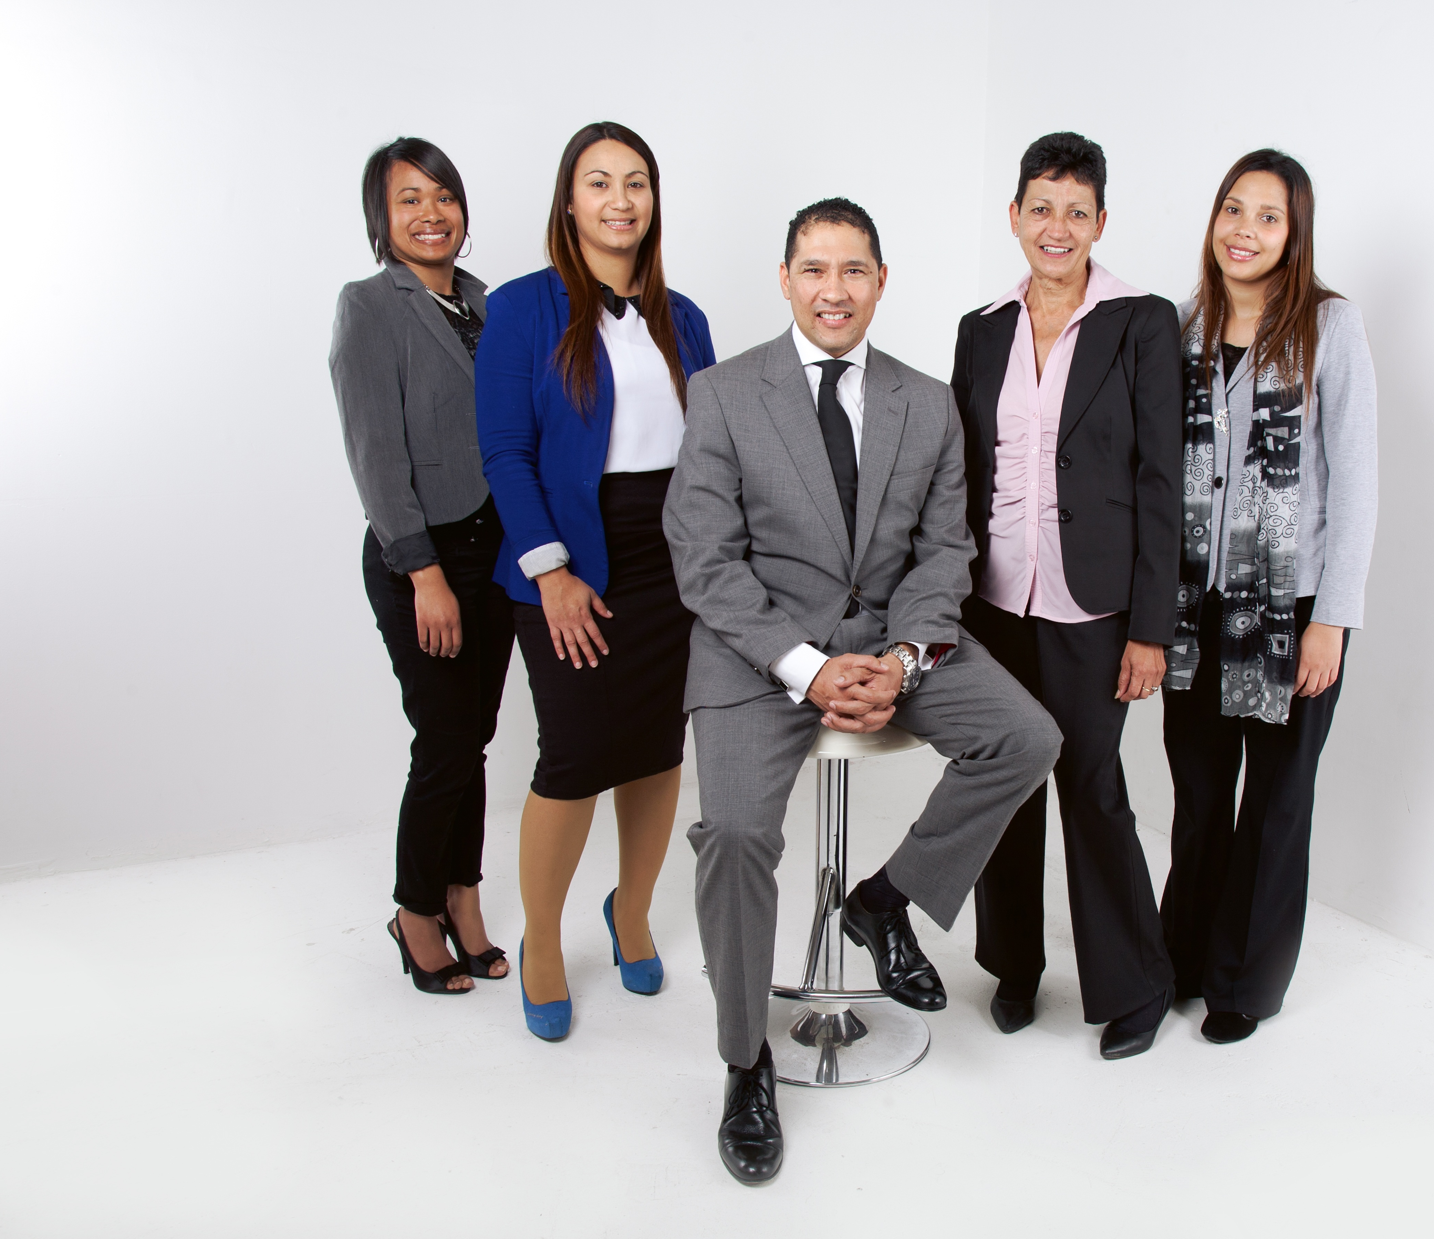
Internal Stakeholders
Community Management Team (Managers, Directors, Owners, and/or Administrators)
Healthcare / Wellness Staff
Facilities / Maintenance Staff
Leasing Agents
Security and Safety Officers: To ensure safety and reduce chances of theft or trespassing
Legal Counsel: To mitigate reputational risk, lawsuits, and social media blunders
Notes:
Internal insights Speaker Notes:
Employees
Onboarding training for internal employees and leadership on company policies as well as different AI programs on how to effectively use them on projects/assignments
Certified health and fitness professionals for outdoor recreation ( hiking, canoeing, fitness instructors)
Consistent channels of communication via e-mail, Zoom/Microsoft Teams meetings, monthly memos, surveys
Celebrate big and small wins: New resident sign-up, tour confirmed, social engagement broke a record, company recognized in a health magazine for wellness, etc.
Establish and make aware the corporate social responsibilities and crisis management responses (what to know and who to contact in case of emergencies)
Legal experts emphasize that outdoor activities (trails, fitness classes, pools) require waivers, liability releases, and risk management plans to protect operators from lawsuits. Without legal counsel, facilities risk exposure to negligence claims (America Outdoors)
Conduct Employee Satisfaction surveys to build rapport within the company-- make sure our teams voices are heard and make changes when needed; Aim for “Best places to work in NC” morale
Keep employees in the know with monthly meetings with leadership or executives to update them on changes, areas for improvement, and employee acknowledgement and recognition

Slide 6
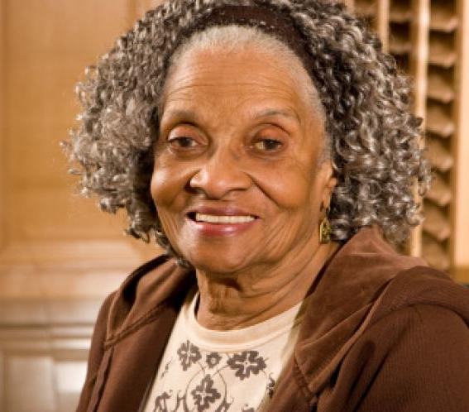
External Stakeholders
Residents
Families of Residents
Vendors & Suppliers
Community Partners
Collaborators
Media (Local, Regional, National)
Emergency Services (Local and Federal)
Healthcare Providers / Hospitals (Local)
Insurance Companies
Government Agencies (Local)
Notes:
External Insights speaker Notes:
Attract big city spenders: Charlotte is the perfect spot to reach executives, managers, and professional audiences that cater to the income level needed to gain residents. “Charlotte is home to major corporate headquarters (Bank of America, Truist, Honeywell, Maersk’s U.S. HQ), creating a dense concentration of executives and high-income professionals” (City of Charlotte)
Forge Sensible Partnerships
Local hospitals & clinics: Create partnerships for preventive health programs
Fitness & wellness providers: Gyms, yoga studios, nutritionists, and physical therapists targeting active older adults
U.S. National Whitewater Service
Pushes the active life narrative by offering mountain biking, yoga, and race series for runners amongst other outdoor recreational activities creating a cohesive brand experience
Aligns with Summit Communities brand image and reaches the target audience by message of adventure
Eliminates the average thinking of “housing” and appeals to Boomers and Gen X who reject passive retirement.
Made by Mountains Partnership
A neighboring outdoor organization in the Western Carolinas; promotes local branding and awareness

Slide 7

Recommended Key Message
Active Lifestyle
Where adventure starts here and community connection guides the way

Slide 8
Communications Objectives
Marketing & Public Relations Focus
Primary Audience
Adults 55+, business professionals, recently retired
Brand Positioning & Messaging
Anchor the campaign around #BeatTheSummit, launched through a signature 10K outdoor event
Use “Conquer Your Summit” consistently across billboards, local media, and print
Leverage outdoor advertising to reach audiences during high-attention commute moments
Differentiate from competitors by emphasizing adventure-based living over traditional senior activities
Incorporate medical professionals to reinforce the benefits of adventure therapy and build trust
Content & Social Media Strategy
Employee and Resident Ambassadors share authentic lifestyle content on YouTube and Facebook
Strengthen SEO and visibility using #ConquerYourSummit #BeatTheSummit #LiveYourSummitLife
Event Marketing & Partnerships
Partner with the U.S. National Whitewater Center and local farmers markets for community-facing events
Notes:
This strategy focuses on reaching active adults 55 and up who still see themselves as engaged and adventurous. Our core message, ‘Conquer Your Summit,’ becomes both the campaign hashtag and the mindset behind the brand. We introduce it through a signature 10K outdoor event and reinforce it across billboards, local media, and print for consistency.
Outdoor advertising is intentional here. Research from Penneco shows billboards are especially effective during commute times, when people are already paying attention, which helps keep the brand top of mind.
We also differentiate ourselves from competitors by moving away from traditional senior programming and leaning into adventure-based living. That message is reinforced through employee and resident ambassadors who share real experiences on Facebook and YouTube, supported by consistent hashtag use to strengthen visibility and SEO.
Finally, partnerships with the U.S. National Whitewater Center and local farmers markets allow us to show the lifestyle in action and create community-facing moments that build trust and engagement.

Slide 9
Communications Objectives (cont’d)
Internal Communications
Educate employees: Set a goal for 95% of staff to complete a training module on a new company policy by the end of the month
Improve employee engagement: Boost engagement by helping employees understand how their roles support company goals through regular team meetings and internal newsletters
On-site tours: Increase tours by 25% over the next quarter using digital storytelling campaigns that highlight resident experiences as social proof
Website traffic: Increase unique website visitors by 30% in six months through SEO, third-party website promotions (Zillow and Apartments.com), and email newsletters
Resident engagement: Host at least 3 events per month to strengthen community, trust, retention, and positive word-of-mouth
Emergency preparedness: Educate teams and residents on responses to severe weather, apartment fires, or injuries/fatalities through newsletters, resident portals, and text alerts

Slide 10
Communications Objectives (cont’d)
Customer Service
Improve resident retention and experience:
  Conduct quarterly surveys that measure activities, services, and overall wellbeing to
  ensure the community evolves with resident needs
  Coordinate designated theme weeks (Green Week, Smart Home Week, Nature Week)
  with the Community Relations Manager to boost word-of-mouth, brand visibility, and
  innovative lifestyle programming
  Instruct residents on how to submit maintenance requests, dietary/meal requests, and
  activity sign-ups through the resident portal
  Build transparency by sharing clear updates on service improvements, policy changes,
  and issue resolutions to reinforce trust

Slide 11
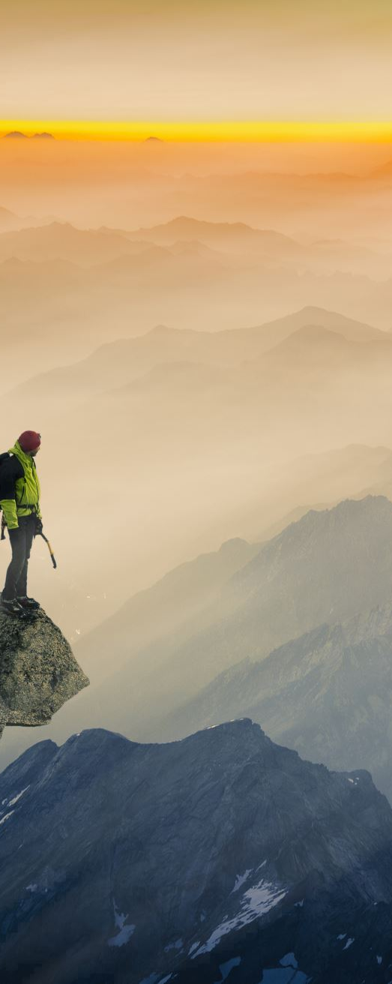
Big Idea
#ConquerYourSummit
  “Conquer Your Summit” is Summit Living’s invitation for adults 55+ to step confidently into a new chapter of life filled with adventure, purpose, and community. It reflects the spirit of the outdoors, the freedom to grow, and the belief that the best version of life is still ahead.
How We Communicate the Big Idea
  Gain local attention
  Build strong social proof
  Demonstrate environmental stewardship
Why It Matters
  Showing Summit as a place where residents can live the best version of themselves across multiple avenues helps the audience understand the positive impact Summit can have - and how it can truly change people’s lives.

Slide 12
Channels
Social Media Platforms
• Instagram
• Facebook
• YouTube
• TikTok
Local News Outlets
• WSOC-TV
• Davidson News
• Charlotte Observer.
Online Blogs & Newsletters
• Atrium Health Newsletter
• Summit Living online blog
Direct Marketing Activities
Flyers and informative brochures handed out at tabling events
Billboards strategically designed and placed in high-volume highways

Slide 13
Content Topic 1: Going Local
Overview
To promote the idea of #ConqueringYourSummit, one aspect of our content plan is to “go local.”
There are several strong partnership opportunities in the surrounding area that align with Summit’s mission, and these partnerships create opportunities for residents to build their own communities and grow in all aspects of their lives.
Two Local Initiatives
Locally Active
  Summit connects with the community through activity-based events happening across the metropolitan area
Locally Healthy
  Summit partners with local health and wellness businesses and organizations to support holistic wellbeing

Slide 14
Story Idea: Locally Active (Going Local)
Overview
  Because Summit Living is rooted in activity and adventure, connecting with local communities through existing adventure-based events is a natural fit.
Event Partnership: “Raft the Summit”
  Sponsored by Summit Living at the U.S. National Whitewater Center, home to the world’s largest man-made whitewater river
  Aligns with Summit’s active and adventure-based brand identity and offers high-visibility community engagement
Event Partnership: Run for Green
  Existing race series presented by Davidson Lands Conservancy
  A strong match for Summit due to shared values around environmental stewardship and a yearn for physical activity
Special Co-Created Event
  Summit and Run for Green collaborate on the “#BeatTheSummit Race,” which is a 10K race.
  Includes additional 5K and 3K walk options for different fitness levels
  Engages locals, builds visibility, and introduces participants to Summit’s mission and lifestyle

Slide 15
Channels: Locally Active
Local Media Outreach
Atrium Health Newsletter - a strong local health partner to help share event news
Davidson News
Charlotte Observer
WSOC-TV
Social Media Promotion
Organic posts in local Charlotte/Davidson fitness-related Facebook groups
Organic posts in marathon and running Facebook groups
Potential organic posts from local run clubs on Instagram
Paid social advertising
Post-event YouTube videos to extend reach and engagement

Slide 16
Story Idea: Locally Healthy (Going Local)
Overview
Locally Healthy is an initiative that connects Summit Living with local health and wellness–focused businesses.
While Summit’s foundation is activity and adventure, the larger goal is helping members become the best versions of themselves - physically, mentally, and spiritually.
Partnerships with Local Farmers Markets
  Healthy eating is a major touchpoint for our audience
  Partnerships include:
    Charlotte Regional Farmers Market (year-round indoor market)
    Davidson Farmers Market (April–Thanksgiving)
    Uses: Tabling and vendor opportunities Sourcing fresh food options for Summit dining and programming
Wellness Partnership with Prama Institute
  Prama is a leading health and wellness institute in the Charlotte region
  Potential collaborations include:
    Tailored spa and wellness treatments
    Meditation classes
    Yoga classes
    Instructors can teach on site at Summit, and residents can also attend programs at Prama

Slide 17
Channels: Locally Healthy
Social Media
Instagram — highlight collaborations through cross-collab posts featuring:
  Tabling events at farmers markets
  Summit Spa trips to Prama
  Photos of meals prepared with market-sourced ingredients
Facebook — run Facebook ads in collaboration with Prama Health to expand reach and build awareness among their audience
News Coverage
Leverage local news outlets to showcase Summit’s partnerships with health and wellness businesses
Raises community awareness of Summit’s wellness-focused events and collaborations
Blogs
Summit Living blog and Prama’s blog will feature resident experiences from spa treatments, meditation classes, and other wellness activities
Blogs can highlight success stories that demonstrate the therapeutic impact of these partnerships

Slide 18
Content Topic 2: Social Proof
According to the Reuters Institute, 54% of Americans get their news from social media, including Facebook, X, and YouTube.
Because of this, social proof is essential for building trust and visibility for Summit Living.
To showcase how people can “Conquer their Summit,” Summit will launch two UGC-driven social media initiatives under the theme #LiveYourSummitLife.
This content will be created from two perspectives:
– Resident POV
– Employee POV
The Summit Living communications team will partner with residents and employees to develop a content style guide and create themes that feel natural, authentic, and empowering for them.

Slide 19
Story Idea 1: Life at Summit as a Resident (Social Proof)
Summit’s communications team will work with residents to identify and recruit volunteers who want to serve as Summit Ambassadors.
Ambassadors will help create UGC content:
  “Day in the life” (resident POV) videos
  Food vlogs
  Light activity vlogs
  Group-based interactive videos
  Resident interviews and testimonials
Ambassadors may also create videos with their families discussing:
  Why they chose Summit Living
  How Summit has been a form of therapy for them
Photo content will include:
  Family moments
  Photos with other residents
  Action and activity photos

Slide 20
Story Idea 2: Life at Summit as an Employee (Social Proof)
Summit will identify employees who want to serve as Employee Ambassadors and create UGC content of their own.
Employees will follow the style guide developed by the Summit Communications team.
Content will include:
  Daily interactions with residents
  BTS (behind-the-scenes) footage of setting up for an adventure or class
  BTS videos of chefs preparing meals
  Daily fun staff interactions
  Employee testimonials on why they chose to work at Summit

Slide 21
Story Idea 2: Channels
Social media will be the primary channel for this initiative. Platforms include:
TikTok — short-form videos featuring employee trends and UGC content
Instagram Reels — repurposed TikTok content plus resident-focused videos (ideal for our audience demographics)
Facebook Reels — repurposed IG/TikTok content to reach local community groups
YouTube — long-form videos highlighting adventure prep, employee interactions, and behind-the-scenes stories

Slide 22
Content Topic 3: Showing Love to the Planet
Overview
Connecting with nature is inherently community-oriented, and Summit Living takes pride in supporting environmental care as part of its culture and values.
How Summit Engages with the Environment
Summit Green Week Initiative: A community-wide week focused on outdoor engagement, sustainability learning, and hands-on conservation activities.
Summit Garden: A resident-driven garden that encourages mindfulness, community bonding, and healthier food options.
Well-being Connection: These activities reinforce Summit’s belief that caring for the environment also supports mental, physical, and emotional wellness.
Why This Matters
Actively participating in environmental efforts builds trust, attracts like-minded residents, and strengthens family confidence in the community’s values. It also positions Summit as a lifestyle that promotes connection, purpose, and responsibility.

Slide 23
Story Idea 1: #SummitGreenWeek (Showing Love to the Planet)
To reinforce Summit’s commitment to nature and wellbeing, #SummitGreenWeek invites residents to participate in activities that support the environment and build community.
Community Clean-Up Day – Summit partners with a local clean-up group to pick up trash and clean a nearby street.
Recycled Arts & Crafts Day – Residents create fun art projects using recycled materials.
Education Day – A local conservation group visits Summit to share ways residents can help protect and preserve the environment.

Slide 24
#SummitGreenWeek Channels
Instagram – Primary platform for #SummitGreenWeek posts throughout the week.
Instagram Live – Behind-the-scenes look at cleanup activities, workshops, and resident participation.
Facebook – Photo galleries and recap posts to reach local and family audiences.
Summit Website Blog – Resident POV stories or a written recap highlighting the impact of #SummitGreenWeek.

Slide 25
Story Idea 2: The Summit Garden
Year-round gardening program featuring both indoor and outdoor community gardens.
Outdoor garden: Residents plant and maintain flowers, herbs, fruits, and vegetables used by Summit’s culinary team.
Indoor greenery: Residents help select and care for plants throughout shared spaces.
Personal plants: Each resident receives a small plant of their own to grow, display, and keep as a personal keepsake.

Slide 26
Summit Garden: Channels
Social Media
Instagram: Highlight flowers, plants, and meals made with garden-grown produce through Stories, Reels, and in-feed photos/videos.
Facebook: Share similar photo and video updates for the Facebook audience.
TikTok: Short-form clips showing garden moments and #planttok-style content for broader awareness.
YouTube: Longer videos documenting gardening initiatives and resident involvement.
Online Blogs
Resident blog features where residents can share personal reflections on gardening, growth progress, and their experience nurturing plants at Summit.

Slide 27
Insights: Big Idea and Content Topics
Connecting with local vendors and organizations creates meaningful opportunities for residents to engage with like-minded people and build their community.
Partnering with the US Whitewater Center and Davidson Land Conservancy helps showcase Summit’s active lifestyle to a larger audience.
Having 2 different social media POVs can encompass all aspects of Summit Living and appeals to a wide range of audiences, whether it’s families of residents, potential new residents, potential investors/partners, and more.
Actively caring for and taking care of the environment allows for Summit as a collective to grow, and reinforces Summit as a place where wellness includes mind, body, and environment.

Slide 28
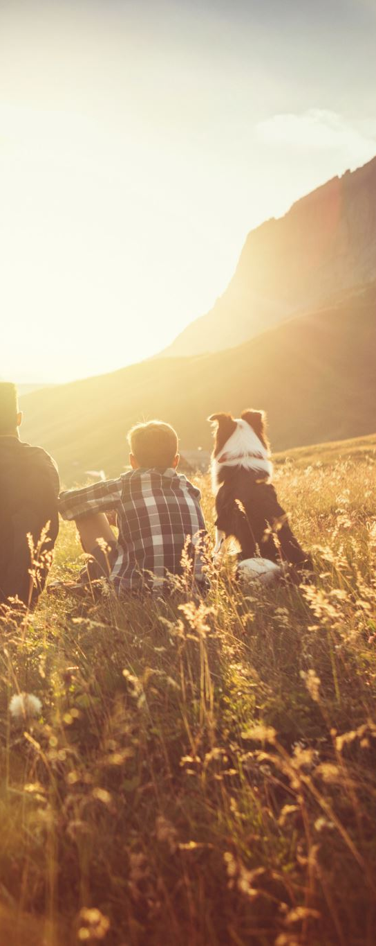
Media Targets for Summit Living
To build trust and visibility in the Davidson–Charlotte area, our media strategy focuses on outlets that reach active adults, their families, and key community voices across local, lifestyle, wellness, business, and outdoor platforms.
Local Trust - Community Credibility
Davidson News
Lake Norman Citizen
Regional Reach - Mass Awareness
The Charlotte Observer
WSOC-TV
Business Influence - Growth & Development
Charlotte Business Journal
Lifestyle, Wellness & Outdoor Living
Charlotte Magazine
AARP North Carolina
Explore Lake Norman
According to Pew Research Center local news remains one of the most trusted sources of information in the U.S., reinforcing the value of prioritizing Davidson- and Charlotte-based outlets for community credibility.

Slide 29
Selective National Media Engagement
National Media Approach
Summit’s national media outreach is intentional and limited, focused on lifestyle and wellness outlets where conversations around active aging and community already exist.
Rather than broad outreach, Summit contributes resident-centered stories that reflect larger cultural shifts.
Priority National Outlets
AARP The Magazine / AARP.org
The New York Times – Well
USA Today – Life & Health
The Washington Post – Lifestyle
National placements are opportunistic and story-led, reinforcing Summit’s credibility without distracting from local engagement goals.

Slide 30
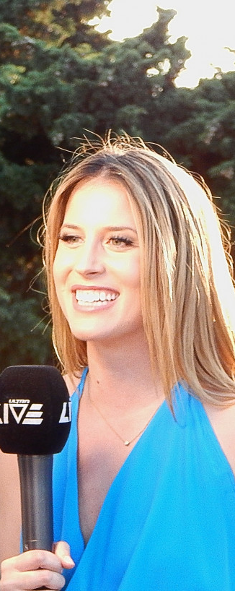
Messages/Stories/Content Tailored to the Media Targets
Each priority outlet will receive a customized pitch based on what its audience already cares about most, so Summit Living shows up as relevant and community-driven, not promotional.
Community Trust
(Davidson News / Lake Norman Citizen)
Resident introductions and community integration
Local partnerships and neighborhood involvement
Regional Visibility
(The Charlotte Observer / WSOC-TV)
Grand opening and milestone moments
Human-interest stories featuring active residents
Growth & Market Relevance
(Charlotte Business Journal)
Economic impact and job creation in Davidson
Demand for modern, wellness-focused living
Lifestyle, Wellness & Outdoor Living
(Charlotte Magazine / AARP North Carolina / Explore Lake Norman)
Day-in-the-life lifestyle features
Active aging through outdoor recreation and social connection
These angles rely on strong, authentic materials, so we focus on real people and real stories. Rotating angles across outlets keeps Summit visible through pre-leasing and opening.

Slide 31
Resources for the Media Targets
To support our media outreach, Summit Living will provide clear facts, authentic voices, and visuals that reflect who we are, making coverage easy and meaningful for every outlet.
Media Kit Essentials
Tailored press releases for key milestones (announcement, pre-leasing, opening)
One-page Summit fact sheet with location, amenities, unit mix, and Davidson economic impact
All materials aligned with Summit’s focus on outdoor living, community connection, and active aging
People & Stories Ready for Interviews
Designated spokespeople: Communications Director, Wellness/Programming lead, and a resident “ambassador” couple
Small story bank featuring early residents (ex: lifelong hiker, retired teacher, grandparent relocating to be closer to family)
Each profile includes 2–3 lines journalists can pull directly into coverage
Stories highlight real residents and authentic experiences, never staged testimonials, to keep Summit’s brand honest and community forward.

Slide 32
Resources for the Media Targets (Cont’d)
Visual & Multimedia Assets
Original photography (no stock) showing residents on Lake Norman trails, in community gardens, and in shared indoor/outdoor spaces
Short b-roll clips for TV/digital: walking paths, water views, fitness classes, community gatherings
Simple charts highlighting active-aging trends and local 55+ population patterns
All assets will be housed in a simple “Media” section on the Summit website, with private links tailored by outlet type to reduce friction and make coverage effortless.
Davidson’s 55+ population has grown steadily over the last decade (Town of Davidson).
According to Pew Research Center, journalists are far more likely to cover stories that include multimedia assets.

Slide 33
References
Pew Research Center. (2022). U.S. local news outlets seen as highly trustworthy.
Pew Research Center. (2023). Journalists are more likely to cover stories with strong multimedia assets.
U.S. Census Bureau. (2010–2020). American Community Survey: Davidson, NC – Age demographics.
Microsoft Co-Pilot. (2025). Search query: “Additional outreach programs that haven’t been thought of and include use of AI.”
University of New Hampshire. (n.d.). The impact of community-based adventure therapy on stress and coping skills in adults.
https://scholars.unh.edu/cgi/viewcontent.cgi?article=1052&context=socwork_facpub
Bjonnes, R. (2025, December 3). NC wellness retreat: Prama Institute & Wellness Center.
https://prama.org/
business.com. (n.d.). How small businesses empower their communities.
https://www.business.com/articles/meredith-wood-small-businesses-empower-communities/
Davidson Farmers Market. (n.d.). Lake Norman’s prime market: Davidson Farmers Market.
https://www.davidsonfarmersmarket.org/
Run for Green. (n.d.). https://runsignup.com/Race/Info/NC/Davidson/RunForGreen
Youngs, I. (2025, June 17). Social media now main source of news in US, research suggests.
BBC News. https://www.bbc.com/news/articles/c93lzyxkklpo

