Slide 1
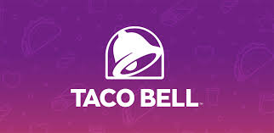
Final Group Project: Taco Bell
Amogh Rao and Christopher Busby
CMS 714 Digital Engagement

Slide 2
Objectives and Strategy

Slide 3
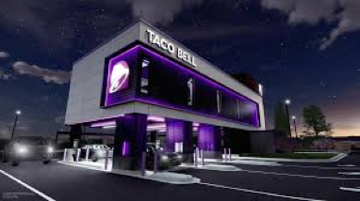
Business Situation
MAIN COMPETITORS:
-McDonalds
-Wendy’s
-KFC
-Del Taco
-Chipotle
FINANCIAL NUMBERS:
-Global Sales (as of Sept. 2024): $15,915,000,000
-Total Units (USA): 7,405
-International Units: 1,159
-Total Units (combined): 8,564
SOCIAL MEDIA NUMBERS:
-FOLLOWERS:
-IG: 1.6 Million
-X: 1.9 Million
-FB: 9.5 Million
-Tik Tok: 3.3 Million

Slide 4
Target Audiences
Primary Audience:
-Taco Bell’s main audience is young adults (Both Gen-Z and Millenials) between the ages of 18-34, who enjoy fast food.
-They enjoy eating tacos especially late at night. They are mostly young professionals who are living out on their own, and at times might feel lazy to cook.
- They enjoy going to happy hours, enjoy trying new foods, and frequent their respective city’s nightlife.

Slide 5
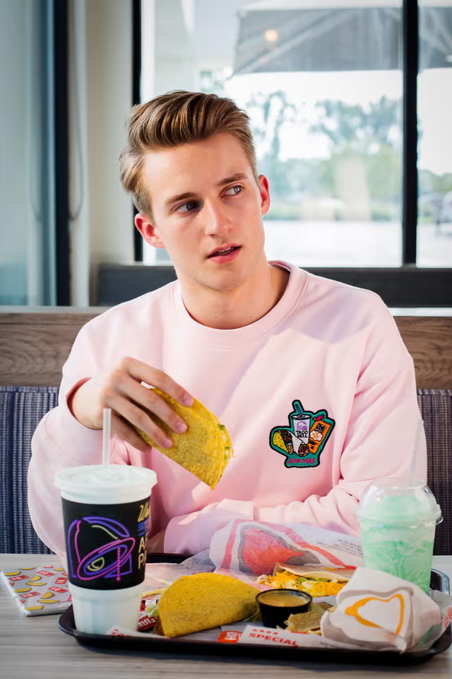
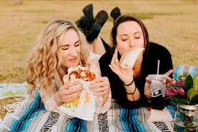
Audience Persona
Name | John
Gender | Male
Age | 24 years old
Education/Profession | Bachelors, just started working as a tech consultant
Location | Washington DC
Interests/Background | John is a recent college graduate who just started in the workforce. He has a roommate, his best friend from college. He likes playing video games, watching sports, and goes out to the bars with his friends on weekends. He’s still getting used to the lifestyle of living on his own (post college), and doesn’t spend much time cooking.
Name | Sarah
Gender | Female
Age | 21 years old
Education/Profession | Working on her Bachelors
Location | Georgetown University (DC)
Interests/Background | Sarah is a junior at Georgetown University in DC. She is majoring in public policy, and just turned 21 years old. Sarah loves spending time with her friends in the city. They are in the same sorority, they explore different shops/restaurants around DC, and have started frequenting the nightlife DC has to offer.

Slide 6
Target Insights
Taco Bell’s target market are mainly the Gen Z crowd, featuring people who enjoy eating tacos and other delicious Mexican-inspired foods, and in stating the obvious, they are in the age range where they don’t need to be super worried about their diets (with exceptions of course). They are people who enjoy going out with their friends on weekends especially to bars and clubs, and will frequent Taco Bell as a late night spot when they’re hungry. The main hours which they might frequent Taco Bell will either be for lunchtime or late night food. The 2-5 PM slot isn’t very frequented by this audience, and that’s a problem which we can solve.
A problem which we can solve is by trying to figure out a way in which people can come to the restaurant at all hours of the day. When doing some research on reddit forums, I saw that former and current employees said that mornings and late afternoons (2-5 PM) are the least busiest times. Having a happy-hour style menu gives Taco Bell an opportunity to bring people in at that 2-5:30/6 range, which is what we will try to solve with the idea and creative concept.

Slide 7
Communication Objectives
Objective # 1:
Increase Customers Monthly
  With the addition of the “happiest hour” campaign as well as other marketing tactics such as social media posts and discounts, we want to have a 4% increase in overall customers in the month of January compared to our December numbers. With our communications methods, we hope to bring in both a new batch of customers, as well as keeping our old ones. Highlighting new products and posting more user generated content will hopefully help achieve that goal. People are attracted to UGC and has great influence.
Objective # 2:
Increase Sales in the 2-5 PM time frame
  Our goal with this campaign is to increase sales specifically at a time period where sales are traditionally low. The busiest time period for most locations is 9p-2m. Our emphasis on the 2p-5p time frame is built around the thought of making access easier than any of our competitors. Using influencers to drive home our big idea, as well as email reminders, and in-app pop-ups during this time should work to our advantage. Although breakfast is the weakest time of day for traffic, stores have added delivery, and walk-up windows for digital orders to help the Happiest Hour campaign succeed. We are looking to increase sales by at least 3% just as late night visits increase.
Notes:
Objective 1:
With the addition of the “happiest hour” campaign as well as other marketing tactics such as social media posts and discounts, we want to have a 4% increase in overall customers in the month of January compared to our December numbers. With our communications methods, we hope to bring in both a new batch of customers, as well as keeping our old ones. Highlighting new products and posting more user generated content will hopefully help achieve that goal. People are attracted to UGC and has great influence.
Objective 2:
Our goal with this campaign is to increase sales specifically at a time period where sales are traditionally low. The busiest time period for most locations is 9p-2m. Our emphasis on the 2p-5p time frame is built around the thought of making access easier than any of our competitors. Using influencers to drive home our big idea, as well as email reminders, and in-app pop-ups during this time should work to our advantage. Although breakfast is the weakest time of day for traffic, stores have added delivery, and walk-up windows for digital orders to help the Happiest Hour campaign succeed. We are looking to increase sales by at least 3% just as late night visits increase.

Slide 8
Communication Objectives Part 2
Objective # 3:
Stand out from the competition via health, as well as social media
  Our Happy Hour Style menu is another option to help us stand out from the competition. This also allows us to increase the positive mentions, as well influencer interaction with our social media presence. Using talented content creators reminds our customers why they love our current menu plus the added Happiest Hour discounts. We want to increase our followers on Instagram by 8% on Instagram, X, and Tik Tok. We want to also grow and maintain a 3.5% engagement rate on Instagram as well through the content we create in this campaign.

Slide 9
Key Messaging
With our messaging, I want the Taco Bell audience to always believe that the customer is always top of mind. Whether it’s the products themselves, the deals, the content, or more, the customer base is going to always be the most important. Through our content, customers will see that the brand is always looking at unique and innovative ways in which they can create new things for the customers, and with relate to them as well.

Slide 10
The Big Idea and Creative Concept

Slide 11
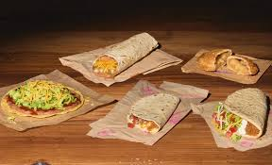
Big Idea
The idea we want to reinforce with our customers is that we want our customers to feel happy when consuming Taco Bell. More specifically, you can happily enjoy Taco Bell at ALL hours of the day. We’ve made our name for being a premier late-night food spot, but Taco Bell is more than just that. Taco Bell is something people can enjoy at all hours. The breakfast menu allows for them to enjoy it in the mornings, and our Happiest-Hour menu will allow them to really enjoy it in the late afternoons as well. In the end, we want people to look at Taco Bell as a spot which people can go to at anytime and have a great experience!

Slide 12
Creative Concept
Customers feel the happiest when they can get yummy food and beverages for an affordable price. That is a major concept of “happy hour” at different restaurants, and is something which the target audience loves to participate in. Taco Bell already has a “happier hour” where they have deals on their sodas and frozen drinks from 2-5 PM, so why not also introduce a “happiest hour” where there are different deals on food at those times as well. Having a slogan which says “You’re happiness is waiting for you. Live Mas.” will be a good way to draw in customers, and finding creative ways to advertise it using social media will also be important.

Slide 13
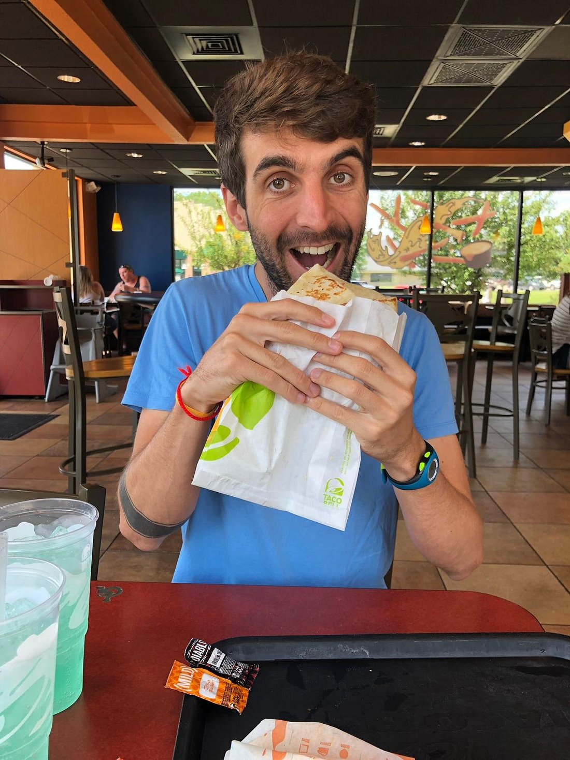
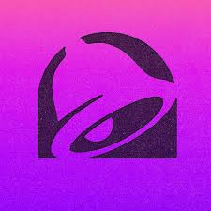
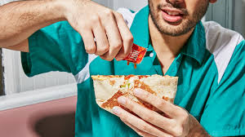
Digital Channels
Being that our target audience is Gen-Z and Millennials, between the ages of 18-34, all digital channels are viable options to market our big idea. Email blast to our established customers, who’s contact information we already have. Social Media post, and videos during drive times to solidify our message to young adults debating meal options, as well busy families that are stuck in traffic or waiting for kids after school. If they currently have the restaurant’s mobile app, a screen covering pop up would also reinforce our new campaign.

Slide 14
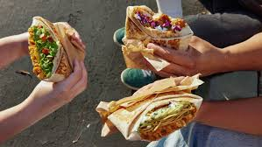
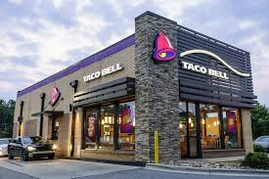
Content topic 1:Families looking to have fast affordable meals.
Reach our target audience through mid-day social media posts and videos reminding them that Taco Bell’s food happiest hour is the perfect quick meal, using popular memes, and music. Pop up ads on websites that students frequent will also be helpful.
Create social media content with videos of testimonials of other overwhelmed adults taking advantage of the happiest hour menu. This goal could also be completed by purchasing ads with popular podcast.

Slide 15
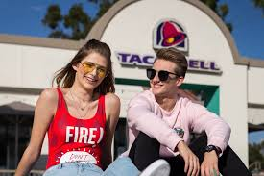
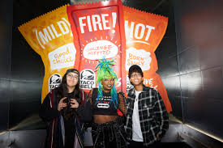
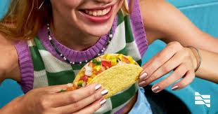
Content topic 2. Single Gen Z customers.
Use email marketing to send discount codes and menu specials to our customers. We will also use the existing mobile app to contact existing customers also would be useful. Also adding advertising to website frequented by office workers.
Our content will create the illusion that the happiest hour is also perfect for at- home dates. Ideal channels for this would apps like Instagram, Tik Tok, X, as well as advertising inside of dating apps.

Slide 16
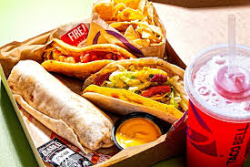
Content Topic 3. Quick snack all ages
1.Some customers may not see this as a meal, but more of a snack opportunity. Using digital channels such as video ads, google ads and social media by offering deep discounts, or free items for first time app users. Using email to drive app, and website traffic would also be ideal.
2.Using analytics to track and target people searching the internet or social media for “tacos” “Mexican Food” or “dinner deals” using social media to send targeted funny videos, memes, and customer testimonials to drive home our big idea that the Happiest Hour at Taco Bell is their best option for an after work/school snack to get through the evening.

Slide 17
Social Media Strategy
●Brand Voice: Positive, Energetic, Uplifting, and an overall fun tone.
●Platforms (and content ideas for each one):
Instagram: IG reels, photos of different foods, graphics promoting our happiest hour menu, influencer partnerships, as well as paid advertisements via story as well as in-feed posts
Tik Tok: UGC videos of taco bell consumption, food review style videos, videos playing on different trends, more influencer promotion.
X: Fun tweets, audience interaction via replies, new menu item announcements
Youtube: Repurpose TV commercials on there, other longer-form videos highlighting specific menu items and BTS content of items being made, etc.

Slide 18
Social Media Strategy part 2
Ways to get UGC:
1.Create a #HappiestHour hashtag (along with the current #LiveMas) for people to use when creating their own posts about our products.
2.Announce a video series on IG called “What brings you your happiness?” where fans can create videos of themselves with their favorite menu items. Repost those videos on IG in-feed or stories. Going even further, if there is a popular menu item which many people talk about, taco bell can add it to their Happiest Hour menu.
3.Retweet engaging and fun tweets people make about the brand
4.Have employees at different branches create their own content as well, whether it’s them talking about their favorite menu hacks, new item promotions, etc.

Slide 19
Influencer Strategy
Influencers to partner with:
-Mr.Chimetime (2.1M on Tik Tok): He’s a popular food influencer who tries and rates restaurants. He has partnered with Taco Bell in the past so we know he’s someone who believes in the brand.
-Alix Earle (7.1M on Tik Tok): Very popular with the Gen-Z crowd and is an ideal fit for Taco Bell’s target audience. Creates content on just about everything (beauty, Day-in-life, etc) so would be great for this.
-Kel Cripe (317.7K on Tik Tok): Creates lots of comedy content and does sketches, stand-ups, etc. Their content fits Taco Bell’s brand voice, and they’ve also been a taco bell partner in the past.

Slide 20
Influencer Strategy part 2
The influencer strategy would be to have different types of videos to promote the ”Happiest Hour” menu. Having Mr. Chimetime review some of Taco Bell’s exclusive items from that menu (hoping he will like it!) would be one video idea. Having Alix Earle do a ”Day in the life” style video where she feels lazy and goes to taco bell would be another. Lastly, having Kel (reallygoodimpressions) create another funny skit playing on our menu items and names would be great. Having these videos be posted cross-platform on IG reels to engage the audience there will also be important.
Having a combination of both giving these influencers discounts as well as paying them monetarily will be the strategy in payment methods. I picked these three influencers because of their connection to the food scene, their ability to connect with our audience as well as their ability to maintain our brand voice through it all.

Slide 21
SEO and Email Strategy
For their SEO strategy, we will have a strategy covering both on and off-page SEO. For the On-page SEO strategy, we will implement links within all web content which will take them to the happiest hour menu page. Having banner ads in the homepage, as well as promo copy in other parts of the site to direct users to the Happiest Hour site will be important. Using words such as “promotion” and “deals” would be key. For off-page, having search ads to boost Taco Bell when people search for anything related to happy hour will be implemented. Also, partnering with different podcasts that fit our target audience who can put our links in their video descriptions, as well as influencers/UGC creators adding either promo links or links to the Happiest Hour page to their stories will be crucial as well.
For email marketing, this strategy won’t be used as much because the target audience isn’t always spending time on emails, but it is still valuable. Sending out emails linking directly to the promotion site, having fun and catchy text copy to promote the “Happiest Hour” as well as images of menu items will be key. Also having discount codes in the email will also be a good idea. 46% of Taco Bell’s email campaigns have promotions in them, so either keeping that or increasing it will be the strategy.

Slide 22
Project Summary
As a group we decided to use Taco Bell because of their ability to continuously reinvent themselves through media of all kinds over many years. By building new campaign from the existing platform of Happier Hour and using several different digital communications channels, we will achieve our goal of targeting different audiences. With the millions served, and millions of followers returning customers have to be top of mind. Continuing with the fun light hearted brand voice “The Happiest Hour” will help keep our existing customers engaged, as well as pick up new customers.

Slide 23
References
Keegan Edwards. (2024, June 1). Understanding Taco Bell’s target market: Strategies and Demographics. https://keeganedwards.com/understanding-taco-bells-target-market-strategies-and-demographics/#:~:text=and%20Gender%20Distribution-,Taco%20Bell%20primarily%20targets%20young%20adults%20and%20teenagers%20aged%2018,food%20destination%20for%20these%20individuals.
Kunst, A. (2022, February 23). Visitors of Taco Bell in the U.S. by age 2018. Statista. https://www.statista.com/statistics/230987/people-who-visited-taco-bell-usa/
10. Taco Bell. franchisetimes.com. (2024, September 27). https://www.franchisetimes.com/top-400-2024/10-taco-bell/article_1bbfd5cc-5659-11ef-817a-9710858b5996.html
Bhargava, V. (2023, November 21). How Taco Bell uses social listening to Win Hearts. Radarr. https://www.radarr.com/blog/how-taco-bell-uses-social-listening-to-win-hearts/#:~:text=2.,develop%20well%2Dsegmented%20marketing%20strategies.
Edwards, K. (2024, June 1). Understanding Taco Bell’s target market: Strategies and Demographics. Keegan Edwards. https://keeganedwards.com/understanding-taco-bells-target-market-strategies-and-demographics/
Rafaqat, A. (2024). How many Taco Bell restaurants are in the United States of America (USA) in 2024? everything you need to know. RSS. https://www.xmap.ai/blog/how-many-taco-bell-restaurants-are-in-the-united-states-of-america-usa-in-2024-everything-you-need-to-know#:~:text=In%202024%2C%20Taco%20Bell%20boasts,enduring%20appeal%20and%20market%20penetration.
Cappelli, S. (2023, November 20). Seo and content marketing: How to combine them effectively. Semrush Blog. https://www.semrush.com/blog/seo-and-content-marketing/?g_acctid=851-605-1869&g_adid=683861103728&g_adgroupid=168155428541&g_network=g&g_adtype=search&g_campaign=US_SRCH_DSA_Blog_EN_Voyantis_V2&g_keyword=&g_keywordid=aud-1958083458700%3Adsa-2263819780079&g_campaignid=21962554712&kw=&cmp=US_SRCH_DSA_Blog_EN_Voyantis_V2&label=dsa_pagefeed&Network=g&Device=c&utm_content=683861103728&kwid=aud-1958083458700%3Adsa-2263819780079&cmpid=21962554712&agpid=168155428541&BU=Core&extid=113634443217&adpos=&gad_source=1&gclid=CjwKCAiA9vS6BhA9EiwAJpnXwylA-_Ev-zucDs4JftgUd0zSrrl9yd6Qn3COjphrCbBfZzQ2Tfw3NhoCctgQAvD_BwE

